Slide 1

Guidelines
Kindly use the given template for submitting your project (Make a copy of the template)
One team is only required to submit one project.
The ideal size of the presentation should not be more than 10 slides.
You are welcome to add as many POCs and design concepts to support your project.
The project should be feasible and the team members should be capable enough, to come up with the prototype of the same idea, if required.
Projects using Google developer technologies like Gemini APIs & building projects on IDX platform will earn additional points.
In case of queries, kindly reach out to us at solutionchallengesupport@hack2skill.com

Slide 2
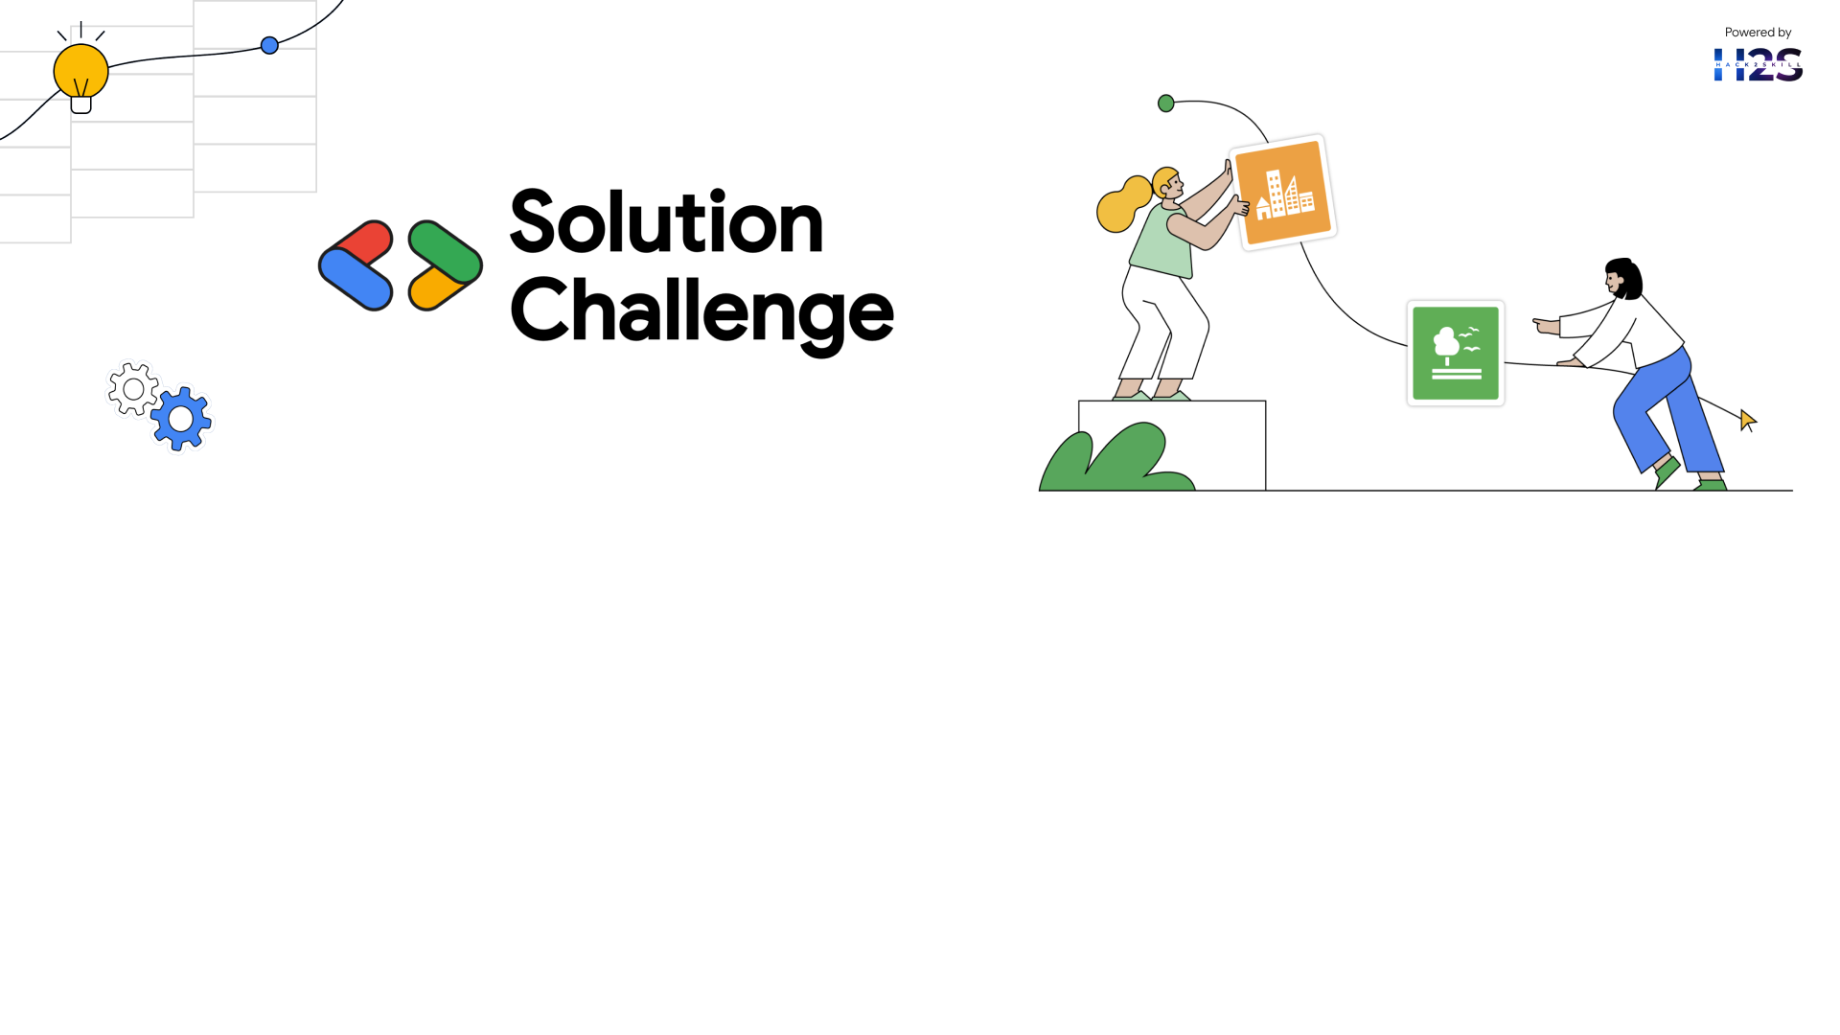
Team Details
Team name: Team NextGen
Team leader name: Saikat Das
Problem Statement: Empowering Small and Marginal Farmers with AI-Driven Agricultural Solutions

Slide 3
Brief about your solution
This solution is a collaboration work of AI, Machine Learning to empower small and marginal farmers by providing personalized agricultural insights.
🔹 AI-Powered Crop Recommendation – Predicts the best crop based on soil health, weather’s historical data. 🔹 Yield Prediction Model – Uses weather patterns, soil moisture, and past trends to forecast crop productivity. 🔹 Soil Health Monitoring – Collected Survey data on the location’s soil data helps to improve soil quality. 🔹 Web Application – Provides real-time access to AI-driven advisory for farmers.
Impact
Increases Yield & Reduces Losses
Optimizes Resource Usage (Water, Fertilizers)
Enhances Climate Resilience
Improves Farmers' Livelihoods

Slide 4
Opportunities
Unlike traditional agricultural advisory systems ideas, this AI-powered solution provides real-time, personalized recommendations based on machine learning, Artificial intelligence. This system continuously learns and adapts to changing climate, soil, and market conditions.
How Will It Solve the Problem?
✅ Data-Driven Crop Selection – AI recommends the best crops based on soil health, weather forecasts, and historical data. ✅ Precision Farming – IoT sensors and satellite data enable real-time monitoring of soil, water, and weather conditions. ✅ Early Pest & Disease Detection – AI detects crop diseases early using image recognition and sensor data, reducing losses. ✅ Smart Irrigation & Resource Management – AI optimizes water and fertilizer usage, preventing overuse and ensuring sustainability.
Most Essential Problem Focused Solution 🔹 Localized & Personalized Advice – Provides customized recommendations based on farm-specific data. 🔹 Climate-Resilient Farming – Helps farmers adapt to unpredictable weather patterns. 🔹 Market Linkages & Financial Support – Connects farmers with buyers, government schemes, and financial resources.

Slide 5
List of features offered by the solution
AI-Powered Crop & Seed Selection – Uses ML to recommend optimal crops and high-yield seeds based on soil quality, weather, and past yield data.
Climate & Weather Prediction – Provides real-time weather forecasts and AI-driven risk analysis to mitigate climate threats.
Disease & Pest Detection – Uses image-based AI to identify pests and diseases, suggesting effective organic or chemical treatments.
Smart Soil Management – Analyzes soil health and recommends fertilizers, promoting sustainable farming practices.
Market Price Prediction & Direct Selling – Forecasts crop demand and prices while connecting farmers to buyers and government schemes.
Web-Based Platform for Easy Access
A farmer-friendly mobile & web app for real-time access to all AI-driven recommendations.

Slide 6
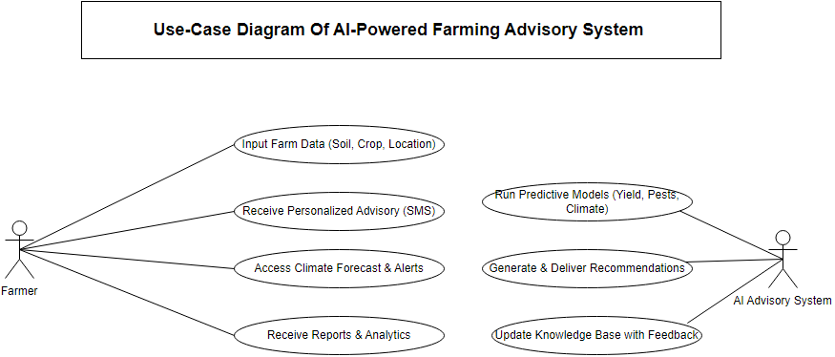
Process flow diagram or Use-case diagram

Slide 7
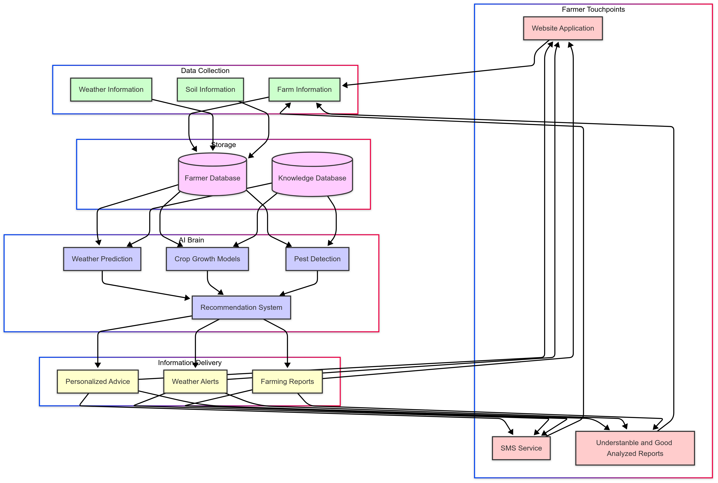
Architecture diagram of the proposed solution

Slide 8
Technologies to be used in the solution
HTML,CSS(Frontend)
Machine Learning
MongoDB,JAVASCRIPT(Backend)
Weather API(OpenWeather.com)
Soil API(AgroMonitoring.com)

Slide 9
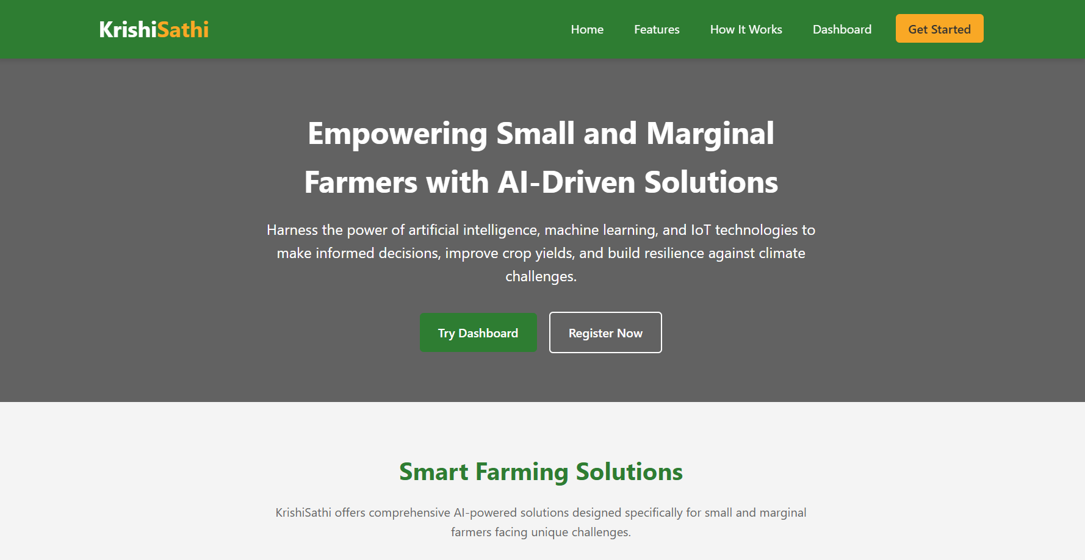
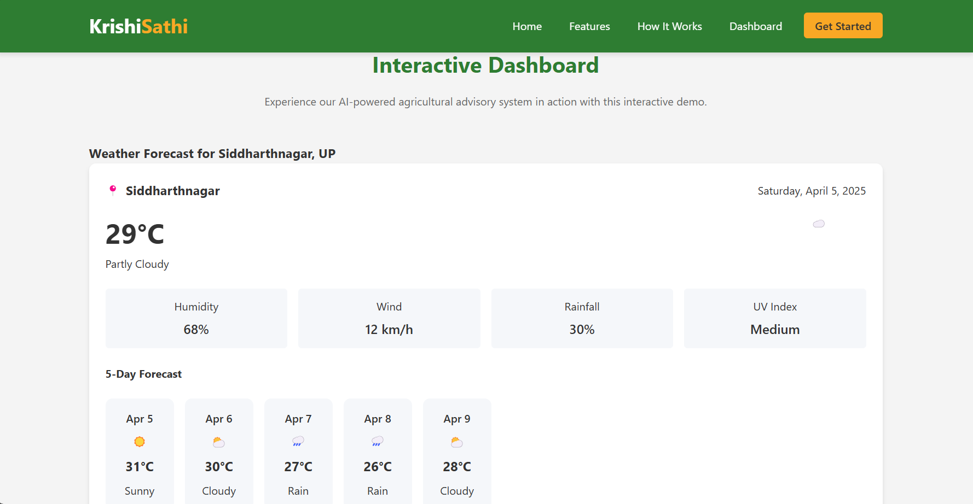
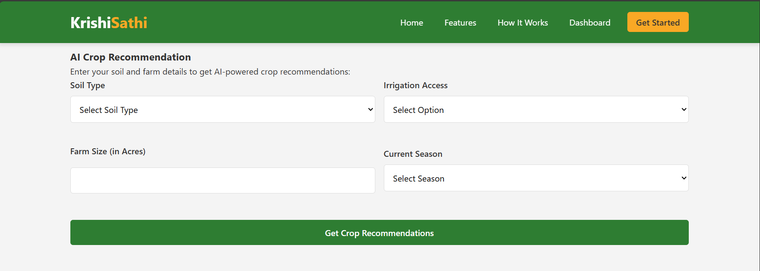
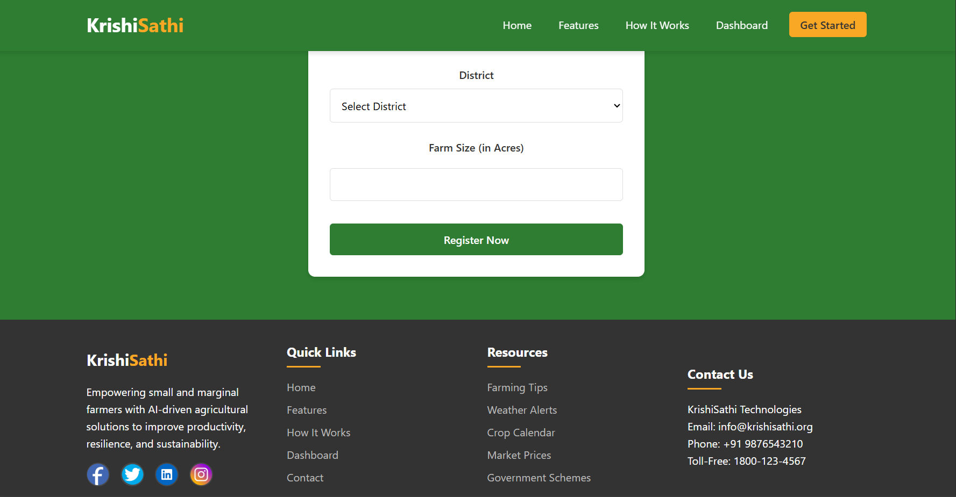
Snapshots of the MVP

Slide 10
Additional Details/Future Development (if any)
Add the Good Database System for Farmers.
Add a Community Section for all the local farmers.
Add a Tutorial section for learning
Add a Market Place where Farmers get the perfect pricing for their corps.

Slide 11
Provide links to your:
GitHub Public Repository : https://github.com/SaikatDash/Empowering-Small-and-Marginal-Farmers-with-AI-Driven-Agricultural-Solutions
Demo Video Link (3 Minutes) :
MVP Link : KrishiSathi - AI-Driven Agricultural Solutions

Slide 12


